Slide 1
Prime Pack
Beef:
Risk Assessment
2024 Security Report
BCYB 640 Final Project:
Mya Zylberberg

Slide 2
Today’s Agenda
01
Company Overview
04
Cybersecurity Challenges
Who we are
Real world and Ours
02
Security Profile
05
Impacts from
Common Threats
Understanding our Tier and current situation
03
Our Baseline
06
Target Benchmarks
Scoring the Essential Cyber Hygiene controls
Planning Priorities and next step actions

Slide 3
01
Company Overview
Some Key Features of our organization are
Food and Agriculture critical infrastructure
Mid-size cattle and meat packing company
Located in upstate NY
2,000 employees and growing
Risk appetite – Moderate

Slide 4
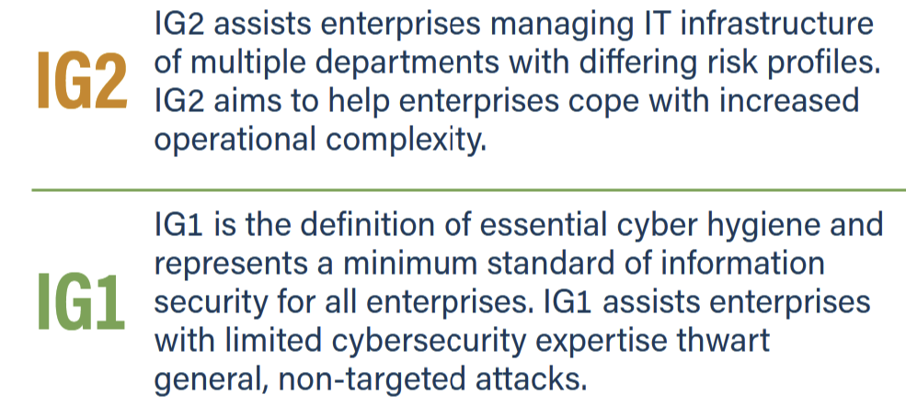
02
Security Profile

Slide 5

03
Our
Baseline

Slide 6
Cybersecurity-Related Challenges
04
Real -World Incidents
JBS Foods Ransomware Assault
Danish Crown Cyberattack
Schreiber Foods Ransomware Incident
Our Incident
Prime Pack Beef Ransomware Incident

Slide 7
Impacts from Common Threats
05
Product Contamination/Quality
Consumer Trust
Financial Losses
Company Reputation
Lawsuits

Slide 8
Organic, Sustainable, Prepared
06
Target Benchmarks
Network Security
Data Encryption
Access Controls & Authentication
Incident Response Plan (IRP) creation
Employee Training & Awareness

Slide 9
Thank you!
Questions?

Slide 10
Sources
White House. (2022). National Security Memorandum on Strengthening the Security and Resilience of U.S. Food and Agriculture. Retrieved from https://www.whitehouse.gov
CISA. (2015). Food and Agriculture Sector-Specific Plan. Retrieved from https://www.cisa.gov
Bloomberg News. (2021). Danish Crown Meat Processor Hit by Cyberattack. Retrieved from https://www.bloomberg.com
National Institute of Standards and Technology. (2018). Framework for Improving Critical Infrastructure Cybersecurity. Retrieved from https://www.nist.gov
Cybersecurity and Infrastructure Security Agency. (2024). Internet of Things Security for Critical Infrastructure. Retrieved from https://www.cisa.gov
A guide to Critical Infrastructure Security and Resilience (2019). Retrieved from https://www.cisa.gov/sites/default/files/publications/nipp-ssp-food-ag-2015-508.pdf

